Slide 1
Optical Transmission Fundamental
v1, 1-Dec

Slide 2
Optical Transmission Fundamentals
What is DWDM?
Optical Basics
Optical Fiber & Impairments
Non Linear Effects
Optical Transmission
Erbium Doped Fiber Amplifiers
OTN Basics
DWDM Technology
DWDM Network Topologies
Optical Transmission Systems Network Design
DWDM Software
Notes:
We will cover:
(read bullets)

Slide 3
What is DWDM?

Slide 4
Dense Wavelength Division Multiplexing
DWDM systems use optical devices to combine the output of several optical transmitters
TX
RX
Transmission
TX
RX
TX
Optical
fiber pair
RX
TX
RX
Optical
transmitters
DWDM devices
Optical
receivers

Slide 5
Traditional TDM Model
STM-64 Tx
STM-64 Rx
STM-64 Rx
STM-64 Tx
STM-64 Tx
STM-64 Rx
STM-64 Rx
STM-64 Tx
STM-64 Tx
STM-64 Rx
STM-64 Rx
STM-64 Tx
STM-64 Tx
STM-64 Rx
STM-64 Rx
STM-64 Tx
STM-64 Tx
STM-64 Rx
STM-64 Rx
STM-64 Tx
STM-64 Tx
STM-64 Rx
STM-64 Rx
STM-64 Tx
STM-64 Tx
STM-64 Rx
STM-64 Rx
STM-64 Tx
STM-64 Tx
STM-64 Rx
STM-64 Rx
STM-64 Tx
One traffic channel per fiber pair
40 x 10 Gbps channels, 80 fibers
Notes:
In the traditional time division multiplexed model, an STM 16 transmission channel would be transmitted over a single fiber. So we have a 2.5 gigabit transmitter, and a 2.5 gigabit receiver at each end of a single fiber. The return channel also goes over a single fiber. So a single channel takes two fibers. If we wanted 40 channels, we would need 80 fibers.

Slide 6
Dense Wavelength Division Multiplexing DWDM
STM-64 Tx
STM-64 Tx
STM-64 Rx
STM-64 Rx
STM-64 Tx
STM-64 Tx
STM-64 Rx
STM-64 Rx
STM-64 Tx
STM-64 Tx
STM-64 Rx
STM-64 Rx
STM-64 Tx
STM-64 Tx
STM-64 Rx
STM-64 Rx
STM-64 Tx
STM-64 Tx
STM-64 Rx
STM-64 Rx
STM-64 Tx
STM-64 Tx
STM-64 Rx
STM-64 Rx
STM-64 Tx
STM-64 Tx
STM-64 Rx
STM-64 Rx
STM-64 Tx
STM-64 Tx
STM-64 Rx
STM-64 Rx
STM-64 Tx
STM-64 Rx
STM-64 Rx
STM-64 Tx
STM-64 Tx
STM-64 Rx
STM-64 Rx
STM-64 Tx
STM-64 Tx
STM-64 Rx
STM-64 Rx
STM-64 Tx
STM-64 Tx
STM-64 Rx
STM-64 Rx
STM-64 Tx
STM-64 Tx
STM-64 Rx
STM-64 Rx
STM-64 Tx
STM-64 Tx
STM-64 Rx
STM-64 Rx
STM-64 Tx
STM-64 Tx
STM-64 Rx
STM-64 Rx
STM-64 Tx
STM-64 Tx
STM-64 Rx
STM-64 Rx
STM-64 Tx
Multiple traffic channels on a fiber pair
Each channel transmitted on a different wavelength/color prevents channel interference and allows them to be separated at the receiving end
40 x 10 Gbps channels, 2 fibers
Notes:
Using Dense Wavelength Division Multiplexing – DWDM - we can reduce the fiber requirement.
Each channel can be transmitted on a different wavelength over a single fiber. So we have our 40 2.5 gigabit channels, each being transmitted as a different wavelength, that is, a different color. They are multiplexed together and transmitted over a single fiber and at the far end demultiplexed. The multiplexer and demultilexer prevent channel interference and allows channels to be separated at the receiving end.
One fiber is needed for the west-east direction, and another for the east-west. So instead of using 80 fibers we use only 2 fibers.

Slide 7
ITU Wavelength Grids
100GHz Grid
Wavelength
λ
1530.33 nm
1553.86 nm
0.80 nm
Frequency
ν
195.9 THz
193.0 THz
100 GHz
50GHz Grid
Wavelength
λ
1530.33 nm
1553.86 nm
Frequency
ν
0.40 nm
195.9 THz
193.0 THz
50 GHz
ITU-T λ grids are based on 191.7 THz + 100 GHz or + 50 GHz
It is a standard for the channels in DWDM systems
Notes:
There are two ITU Standardized wavelength grid spacing's.
On the 100 gigahertz grid, or approximately 0.8 nanometer channel spacing, we get about 40 channels within in the erbium doped fiber bandwidth.
With a 50 gigahertz grid, or approximately 0.4 nanometer channel spacing, up to 80 channels can be transmitted.

Slide 8
TDM and DWDM Comparison
DS-1
DS-3
OC-1
OC-3
OC-12
OC-48
TDM (SONET/SDH)
分時多工
Takes sync or async signals and
multiplexes them to a single
higher optical bit rate.
Uses E/O or O/E/O conversion.
DWDM
分頻多工/分波多工
Takes multiple optical signals
and multiplexes them onto a
single fiber.
If required O/E/O conversion at
ingress for wavelength
conversion.
SONET
ADM
Fiber
OC-48
OC-192
OC-768
GE
ESCON/FC
ATM
OEO
DWDM Mux
OEO
Fiber
OEO
Notes:
In Time Division Multiplexing, TDM, synchronous or asynchronous signals are multiplexed to a single higher optical bit rate.
In Dense Wavelength Division Multiplexing, DWDM, multiple optical channels are multiplexed onto a single fiber. In some cases a transponder is required at the ingress of the system for wavelength conversion of the incoming signal to convert it to a wavelength on the ITU standardized grid.

Slide 9
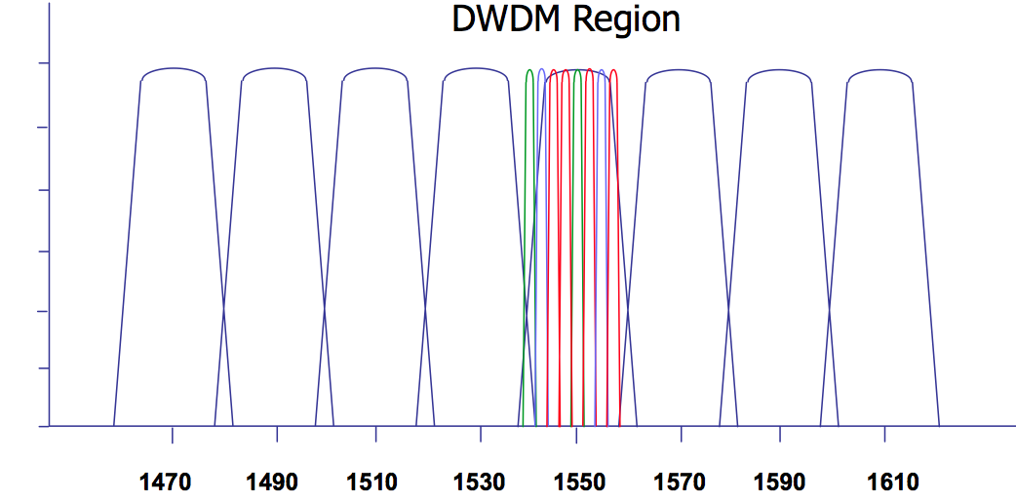
Dense vs Coarse (CWDM vs DWDM)
 | DWDM | CWDM
Application | Long Haul | Metro
Amplifiers | Typically EDFAs | Almost Never
# Channels | Up to 80 | Up to 8
Channel Spacing | 0.4 nm | 20nm
Distance | Up to 3000km | Up to 80km
Spectrum | 1530nm to 1560nm | 1270nm to 1610nm
Filter Technology | Intelligent | Passive

Slide 10
Section 2: Optical Transmission Fundamentals
What is DWDM?
Optical Basics
Optical Fiber & Impairments
Non Linear Effects
Optical Transmission
Erbium Doped Fiber Amplifiers
OTN Basics
DWDM Technology
DWDM Network Topologies
Optical Transmission Systems Network Design
DWDM Software
Notes:
Transition – no script

Slide 11
Optical Spectrum
UltraViolet
Visible
InfraRed
λ
850 nm
1310 nm
1550 nm
1625 nm
Optical communication wavelength bands in the InfraRed:
  850 nm over Multimode fiber
  1310 nm over Singlemode fiber
  C-band:1550 nm over Singlemode fiber
  L-band: 1625 nm over Singlemode fiber
Notes:
The optical spectrum is made up of three regions: an ultra-violet region, a visible region and an infrared region.
Optical communication systems work in the infrared region. The infrared region starts at the edge of the visible region, at about 740 nanometers and extends out to about 300 micrometers.
The first deployed optical transmission systems operated at 850 nanometers over multi-mode fibers. However these fibers had relatively high loss, limited transmission distance and low capacity.
Therefore, single-mode fibers were developed at 1310 nanometers, with lower loss and higher transmission capacity.
With the advent of dense wavelength division multiplexing systems – DWDM - fibers were developed in the 1550 nanometer window – the C-band, and the 1625 nanometer window, or L-band.

Slide 12
Wavelength and Frequency
Wavelength (Lambda λ) of light: in optical communications normally measured in nanometers, 10^{–9}m (nm)
Frequency (ν) in Hertz (Hz): normally expressed in TeraHertz (THz), 10¹² Hz
Converting between wavelength and frequency:
Wavelength x frequency = speed of light ⇒ λ x ν = C
C = 3x10⁸ m/s
For example: 1550 nanometers (nm) = 193.41 terahertz (THz)
Notes:
The ITU have standardized wavelength grids for DWDM transmission systems. These grids are based on the frequency spacing of 100 gigahertz and 50 gigahertz. Therefore, it is useful to be able to convert from optical wavelength and optical frequency.
Optical wavelength is normally measured in nanometers; while optical frequency is measured in terahertz. To convert between wavelength and frequency, we can use this equation:
Optical wavelength times optical frequency equals the speed of light. The speed of light is 3 times 10 to the eight meters per second. As an example, 1550 nanometers is equivalent to 193.41 terahertz.

Slide 13
Optical Power and dBm
The optical power of a signal can be measured in milliwatts (mW)
dBm is the optical power expressed in decibels relative to one milliwatt
Power in dBm = 10 log₁₀ [Optical power (mW)/1mW]
Examples:
Optical Power mW | Optical Power dBm
0.1 mW | -10 dBm
1.0 mW | 0 dBm
2.0 mW | +3 dBm
10 mW | +10 dBm
100 mW | +20 dBm
10倍: 10dBm
2倍: 3dBm
Notes:
The optical power of a signal is measured in watts. Typical optical signals are in the millowatt and microwatt range.
dBm is the optical power expressed in decibels relative to 1 milliwatt. We can convert optical power in milliwatts to power in dBm using this equation: 10 times the optical power in milliwatts divided by 1 milliwatt.
For example, 1 millowatt of optical power is equivalent to zero dBm. If we double the power from 1 milliwatt to 2 milliwatts, this increases the optical power by 3 db, so we have an optical power of plus 3 dBm. Likewise, 10 milliwatts is equivalent to plus 10 dBm; 100 milliwatts to plus 20 dBm.

Slide 14
Optical Transmission Fundamentals
What is DWDM?
Optical Basics
Optical Fiber
Non Linear Effects
Optical Transmission
Erbium Doped Fiber Amplifiers
OTN Basics
DWDM Technology
DWDM Network Topologies
Optical Transmission Systems Network Design
DWDM Software
Notes:
Transition – no script

Slide 15
Fiber Development Timeline
Introduction of Lucent TrueWave non-zero dispersion shifted fiber
Introduction of Corning 50/125 um fiber
Introduction of Corning 62.5/125 um multimode fiber
Introduction of Lucent TrueWave RS reduced slope non-zero dispersion shifted fiber
Introduction of Corning SMF/DS dispersion shifted fiber
1986
1976
1993
1985
1998
Introduction of Corning SMF-21 fiber
Introduction of Corning SMF-LS non-zero dispersion shifted fiber
Invention of first
low-loss optical fiber
Introduction of Corning SMF-28 fiber
Introduction of Corning LEAF non-zero dispersion shifted fiber with large effective area
1983
1986
1970
1994
1998
Notes:
Optical fiber technology has been around since the 70s, but it has undergone major changes during that time. Looking at the optical fiber development timeline, the first production fibers were available in 1976. These were multi-mode fibers from Corning, using a transmission wavelength of 850 nanometers.
Over the years, fiber development was driven by the need for higher capacity at longer distances. This culminated in the development of the SMF 28 fiber by Corning, which was released in in 1986. This is the most universally deployed single-mode fiber, designed for transmission at 1300 nanometers.
Then followed the introduction of non-zero dispersion-shifted fibers which were designed for DWDM transmission and optimized for the 1550 nanometer window.
The non-zero dispersion shifted fibers have low susceptibility to non-linear effects, which occur at high transmission launch powers, found in DWDM transmission systems.

Slide 16
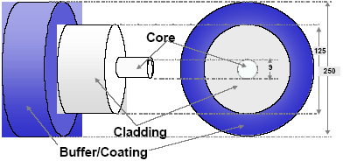
Fiber Geometry and Dimensions
An optical fiber is comprised of three sections:
The core carries the light signals
The refractive index difference between core & cladding confines the light to the core
The coating protects the glass
Core
SMF 8 microns
Cladding
125 microns
Coating
250 microns
Notes:
Let’s take a look at fiber geometry and dimensions. A typical single-mode fiber has two glass regions: the core and the cladding. The light is guided along the fiber by the refractive index difference between the core and cladding. The core has a slightly higher refractive index than the surrounding cladding.
A buffer coating region protects the glass. The core of a single-mode fiber is typically 8 microns in diameter, the cladding 125 microns and the coating is 250 microns.

Slide 17
Propagation in Singlemode Fiber
n₂
Cladding
n₁
Core
Intensity Profile
Light is weakly guided through index difference between core and cladding n₂-n₁
Single mode is transmitted
Mode field travels in core and cladding
Notes:
The propagation in a single-mode fiber is described as weakly guiding. That is, the refractive index difference between the core and the cladding is low and so the light spreads from the core into the cladding.
In this intensity profile of the light across the fiber, the majority of the power travels in the core, but as can be seen there is some travelling in the cladding.

Slide 18
Transmission Degradation
Attenuation, two primary loss mechanisms
  Absorption loss due to impurities
  Scattering loss due to refractive index fluctuations
Chromatic dispersion:
  Wavelengths travel at different speeds (refractive index function of λ)
  Smears pulses because lasers are not perfectly monochromatic
Polarization mode dispersion (PMD):
  Light travels in two orthogonal modes
  If core is nonsymmetric, different modes travel at different speeds
  Issue at high bit rates such as 10 Gbps and higher
Nonlinear effects
  Prevalent at higher signal powers
Notes:
Here we will look at factors that impact the transmission degradation within an optical fiber:
First, attenuation. There are two primary loss mechanisms in a fiber. Absorption loss which is due to the impurities within the glass, and scattering loss which is caused by fluctuations in the refractive index.
Next is chromatic dispersion. This affect tends to spread the optical light pulse in time as it travels along the fiber. This “smearing” of the optical pulses has the effect of reducing the transmission bandwidth and therefore capacity and is due to the fact that lasers are not perfectly monochromatic. The affect occurs because the refractive index of the glass core is a function of wavelength. Any laser light launched into the fiber is not perfectly monochromatic, that is, the laser pulse is made up of a spectrum of optical wavelengths. These different wavelength components travel at different speeds in the glass due to the refractive index dependence on wavelength. Therefore, different optical components take different amounts of time to travel over the length of the fiber, which results in the smearing.
In Polarization Mode Dispersion, or PMD, light travels in two orthogonal electrical modes within the glass. If the core is non-symmetric due to shape or stress across the core, these different modes travel at different speeds again smearing the optical pulse. This issue is particularly bad at high bit rates such as 10 Gigabytes per second and higher.
Also, because of high signal power in the optical fiber, non-linear effects occur, which can be detrimental to transmission. We’ll talk more about this in a moment.

Slide 19
Insertion Loss and Attenuation in Decibels (dB)
Lossy optical component
Transmit Power = P_{tx} (mW)
Receive Power = P_{rx} (mW)
Transmitter
Receiver
The Insertion Loss or Attenuation between transmitter and receiver is expressed by the difference between the transmitted and received power
Attenuation expressed in decibels (dB) is a negative gain, calculated by
10 x log₁₀ P_{rx}/P_{tx} (dB)
If half the power is lost, this is 3 dB
Example: Attenuation = 30 dB means transmitter power is 1000 times the receive power
Notes:
Insertion loss is the amount of light that is lost between the input and the output of a component.
The Insertion Loss, or Attenuation, is expressed by the difference between the transmitted and received power. If we have a transmitter with transmit power of Ptx, and a receiver with receive power of Prx, the insertion loss, or attenuation, can be described by this equation: 10 times the log of the receive power divided by the transmitted power.
If half the power is lost, it is equivalent to 3 dB. As an example, an insertion loss or attenuation of 30 dBs means that the transmitter power is 1000 times that of the receive power.

Slide 20
Optical Fiber Attenuation dB/km
Length = L km
Transmit Power = P_{tx} (μW or mW)
Receive Power = P_{rx} (μW or mW)
Transmitter
Receiver
Fiber attenuation expressed in dB/km, calculated by
10 log₁₀ (P_{tx}/P_{rx})/L
Example:
A fiber of 10 km length has P_{in} = 10 μW and P_{out} = 6 μW
Its loss expressed in dB is
Fiber loss = 10 log₁₀(10/6) = 2.2 dB
And expressed in dB/km = 0.22 dB/Km
Notes:
Optical fiber attenuation is expressed in dBs per kilometer, calculated by this equation.
As an example, a fiber of 10 kilometers has an input power of 10 microwatts and a power out of 6 microwatts. This is expressed as a loss of 2.2 dBs. Expressed in decibels or dBs per kilometer, we divide by the length of the fiber, resulting in a fiber loss of 0.22 dBs per kilometer.

Slide 21
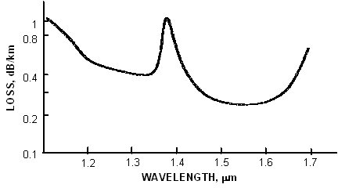
Optical Fiber Attenuation
Fundamental mode
Bending loss
OH Absorption Loss
1550
window
1310
window
Rayleigh scattering loss
Attenuation specified in loss per kilometer (dB/km)
  0.40 dB/km @ 1310 nm, 0.25 dB/km @ 1550 nm
Loss due to absorption by impurities, 1400 nm peak due to OH (water) ions
Rayleigh scattering loss, fundamental limit to fiber loss
Notes:
Here is a loss profile of an optical fiber against wavelength. The solid curve is the actual fiber’s attenuation with wavelength. We see a loss peak at 1400 nanometers between the two operating windows of 1310 and 1550. This loss peak is an absorption loss and is due to “water” or OH within the glass.
The fundamental loss of an optical fiber is determined by the Raleigh scattering loss, shown here by a dotted line. At longer wavelengths, we also see the fundamental mode bending loss. This is due to the fact that as the wavelength increases, the refractive index difference between the core and the cladding reduces and the power spreads into the cladding and therefore is susceptible to bending in the fiber.

Slide 22
Optical Bands
O-band
S-band
C-band
L-band
O-band: 1260 - 1360 nm
S-band: 1460 - 1530 nm
C-band: 1530 - 1565 nm
L-band: 1565 - 1625 nm
Notes:
There are 4 common optical bands. The O band, or original band is between 1260 and 1360 nanometers. The S or Short wavelength band is between 1460 and 1530, the conventional band, or C-band is between 1530 and 1565, and the long wavelength band , or L band, is between 1565 and 1625 nanometers.
The majority of DWDM systems deployed today work within the C-band between 1530 to 1565 nanometers. The L-band, adjacent to the C-band is also used to give additional channel count, and therefore additional capacity.

Slide 23
Fiber Chromatic Dispersion
Chromatic dispersion causes a broadening in time of the input signal as it travels down the length of the fiber.
The phenomenon occurs because the optical signal has a finite spectral width, and different spectral components will propagate at different speeds along the length of the fiber.
The cause of this velocity difference is that the index of refraction of the fiber core is different for different wavelengths.
This is called material dispersion and it is the dominant source of chromatic dispersion in single-mode fibers.
Variation of Chromatic Dispersion with wavelength for Standard SingleMode fiber (>95% of installed fiber)
20
Dispersion ps/nm-km
0
1310 nm
1550nm
Wavelength λ
Notes:
Chromatic dispersion causes a broadening in time of the input signal as it travels down the length of the fiber.
The phenomenon occurs because the optical signal has a finite spectral width, and different spectral components will propagate at different speeds along the length of the fiber.
The cause of this velocity difference is that the index of refraction of the fiber core is different for different wavelengths.
This is called material dispersion and it is the dominant source of chromatic dispersion in single-mode fibers.
Here we are looking at the dispersion versus wavelength for a typical single-mode fiber. You can see that the dispersion is zero in the 1310 nanometers region. A digital transmission system operating at the zero dispersion wavelength will have the greatest bandwidth or capacity. At the zero dispersion wavelength the system is more tolerant to a broad spectrum transmitter as deployed in early single mode fiber systems. At 1550 nanometers, where today’s DWDM transmission operate, we have a relatively high dispersion and so the transmitters must have a narrow optical spectrum in order to achieve high bandwidth or capacity.

Slide 24
Fiber Dispersion Characteristics
Standard SingleMode Fiber
>95% installed fiber
20
Dispersion ps/nm-km
0
1310 nm
1550nm
Wavelength λ
Non-zero dispersion shifted fibers (NZDSF)
Lower dispersion in 1550nm window
+4
Lucent TW+
Corning Leaf
+2
Dispersion (ps/nm -km)
Corning DSF
1530 1540 1550 1560nm
- 2
Corning LS
- 4
Notes:
This chart shows dispersion along the vertical axis and wavelength on the horizontal access. The standard single mode fiber has a zero dispersion wavelength of 1310 nanometers.
Transmission wavelengths moved to 1550 nanometers to take advantage of the lower fiber loss in this region. However, as seen, for standard single mode fiber the dispersion is not zero in this region. Therefore to improve the capacity of the fiber for DWDM transmission, fibers were developed with zero dispersion wavelength around 1550 nanometers.
Here, we see the various fiber types: Corning dispersion shifted fiber or DSF with zero dispersion at 1550, Corning LS with zero dispersion at 1560, and the Lucent Truewave and Corning Leaf fibers with zero dispersion lower than 1530.
Ideally, you do NOT want the zero dispersion wavelength to be in the middle of the DWDM transmission window as with Corning DSF, as this can impact the non-linear performance. And ideally the zero dispersion wavelength should be shorter than 1530 nanometers as in the case of TrueWave Plus and Corning Leaf non-zero dispersion shifted fibers.

Slide 25
Dispersion Limitation
Dispersion limitation is defined by the dispersion tolerance of the transmitter and the receiver
Total dispersion is calculated from the fiber dispersion characteristics and the fiber length for any channel or traffic path
The effect of fiber dispersion should be taken into account in the power budget as the dispersion penalty budget
If any channel hit the dispersion limit, the dispersion should be compensated or the channel signal should be regenerated (O-E-O)
Doubling of bit rate results in an increase of dispersion penalty of up to four times
Notes:
Dispersion limitation is defined by the dispersion tolerance of the transmitter and the receiver in the system. Total dispersion is calculated from the fiber dispersion characteristics and the fiber length for any channel or traffic path.
The effect of fiber dispersion should be taken into account in the power budget as the dispersion penalty budget. If any channel hits the dispersion limit, the dispersion should be compensated or the channel signal should be regenerated through optical to optical-to-electrical regeneration.
Note that doubling of the bit rate results in an increase of dispersion penalty of up to four times.

Slide 26
Dispersion Limited Transmission Distances
Dispersion Tolerance of Transponder (ps/nm)
Distance (Km) =
Coefficient of Dispersion of Fiber (ps/nm*km)
Dispersion limited transmission distances over SMF fiber (17 ps/nm/km):
Transmission Rate | Modulation format | Dispersion Tolerance | Distance
2.5 Gb/s | External Modulation | 20,000 ps/nm | ~ 1,100 km
2.5 Gb/s | Direct Modulation | 2,400 ps/nm | 140 km
10 Gb/s | External Modulation | 1,200 ps/nm | 70 km
40 Gb/s | External Modulation | 200 ps/nm | 12 km
Notes:
Looking at dispersion limited transmission distance, this transmission distance is determined by the dispersion tolerance of the transponder divided by the dispersion coefficient of the transmission fiber.
In a standard single-mode fiber, we have a dispersion of 17 picoseconds per nanometer kilometer. We can see typical transmission distances are dependent on bit rate, and the type of modulation format used in the transmitter.
As an example, a transmitter at 2.5 gigabits per second, externally modulated, has a transmitter and receiver dispersion tolerance of 20,000 picoseconds per nanometer kilometer and therefore a transmission distance of approximately 1,100 kilometers.
From the table we see that as we increase the bit rate, the transmission distance drops dramatically.

Slide 27
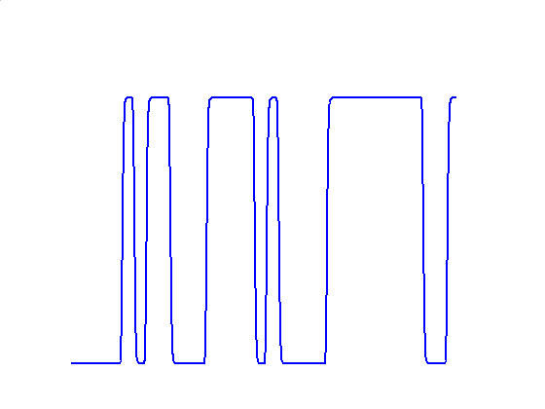
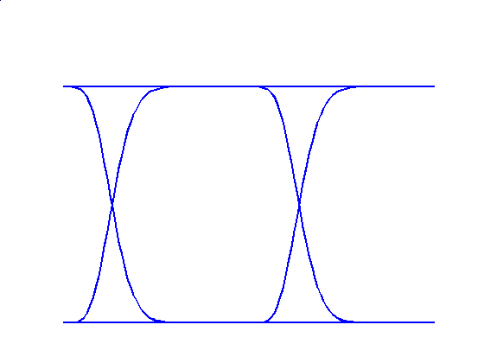
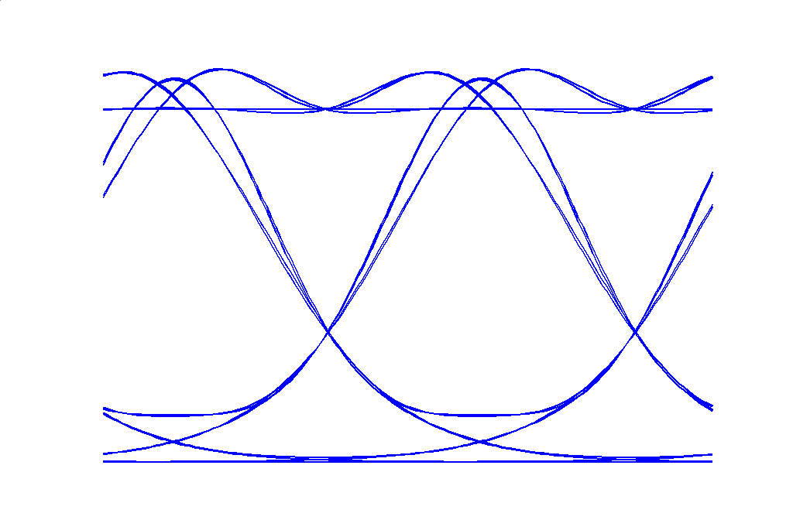
Effect of Chromatic Dispersion
FOLDING
⇒
Tx bit sequence
Eye diagram
no dispersion
In fiber the different frequency components of the signal propagate at different speeds
The effect is signal distortion and intersymbol Interference, the penalty is “eye-closure”
Can be compensated for by the use of Dispersion Compensation
Eye opening
Notes:
In the upper diagram we can see a transmitted bit sequence. These are the ones and zeros which make up the transmitted signal. If we superimpose these ones and zeros, we get an eye-diagram which shows the quality of the transmitted signal.
In the upper diagram the eye is very open. There is virtually no dispersion in the system.
As we mentioned earlier, the different wvaelngth components of the signal propagate at different speeds down the fiber. The result is signal distortion and intersymbol interference and this is seen as a closure of the eye which results in a system penalty. This effect is shown in the lower diagram.
The eye closure and penalty can be compensated for by the use of Dispersion Compensation, which will have the effect of opening up the eye again.

Slide 28
Combating Chromatic Dispersion
Dispersion generally not an issue below 10Gbps
Narrow spectrum laser sources (external modulation) and low chirp* laser sources reduce dispersion penalty. With broad/chirped sources the different spectral components of the source will see different dispersions thus broadening the pulse in time
New fiber types (NZ-DSF) greatly reduce effects
Dispersion compensation techniques
  Dispersion compensation fiber
  Dispersion compensating optical filters
  Dispersion Compensating Units (DCU) generally placed in mid-stage access of EDFA to alleviate DCU insertion loss
  *Chirp: frequency of launched pulse changes with time
Notes:
Dispersion is generally not an issue for transmission speeds lower than 10 Gigabits per second.
To overcome chromatic dispersion, narrow spectrum laser sources and low chirp laser sources can be used to reduce dispersion penalty. However, broadband sources can give increased penalty, as the different spectral components interact with the dispersions to give a broadening the pulse in time.
New fiber types, non-zero dispersion shifted fiber, for example, greatly reduce the effects of dispersion.
Some common dispersion compensation techniques include dispersion compensation fiber and dispersion compensating optical filters. Whichever dispersion compensation technique is used, the Dispersion Compensating Units (DCU) are generally placed in mid-stage access of the EDFA, to alleviate dispersion compensation insertion loss.

Slide 29
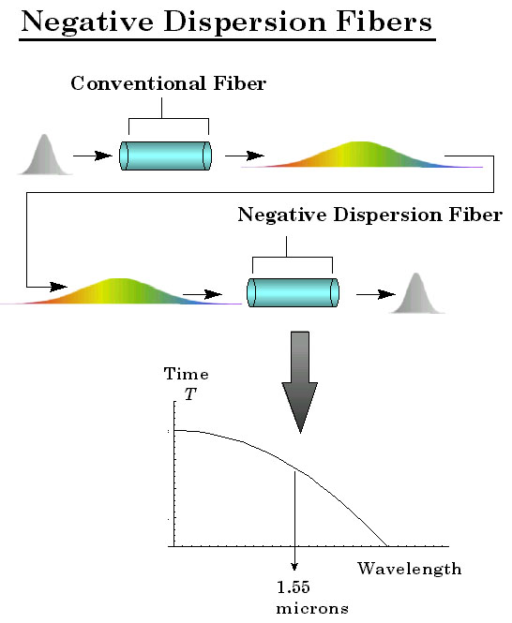
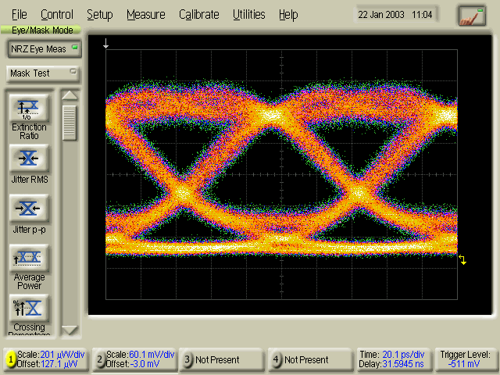
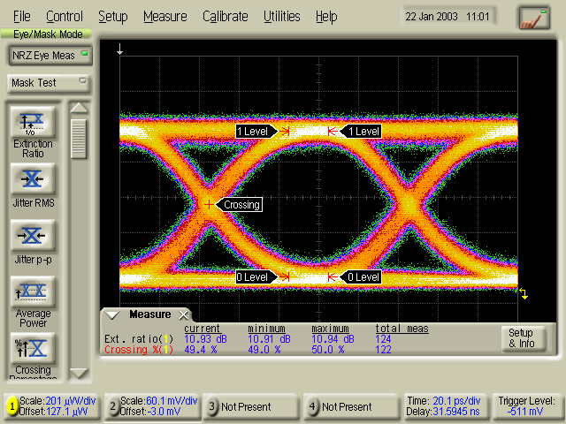
Dispersion Compensating Unit (DCU)
Use of dispersion compensating fiber to combat dispersion
Dispersion Compensating Fiber:
  DCUs use fiber with chromatic dispersion of opposite sign/slope and of suitable length to bring the average dispersion of the link close to zero.
  The compensating fiber can be several kilometers in length, the DCU are typically inserted after each span
Notes:
A DCU is a dispersion compensating unit. Looking at the signal transmission along the fiber, here we have the spectrum in time of our transmitted signal. The signal travels over a length of conventional fiber. At the output the dispersion has spread that pulse in time. Different wavelength components are shown by the different colors, leading to smearing of the pulse.
Feeding the pulse into a negative dispersion, dispersion compensating fiber, the pulse is recompressed and we can get back to the shape of the original transmitted pulse.
Also shown is the eye-diagram of the signal after being transmitted through the conventional fiber. There is eye closure and this will give a transmission penalty. In the eye diagram after the dispersion compensating fiber, the penalty is eliminated.
DCUs use fiber with chromatic dispersion of opposite sign and slope and of suitable length to bring the average dispersion of the link close to zero. The compensating fiber can be several kilometers in length, so the DCUs are typically inserted after each span.

Slide 30
Applications for the Different Fiber Types
SMF
(G.652)
Good for TDM at 1310 nm
OK for TDM at 1550
OK for DWDM (With Dispersion Mgmt)
DSF
(G.653)
OK for TDM at 1310 nm
Good for TDM at 1550 nm
Bad for DWDM (C-Band)
NZDSF
(G.655)
OK for TDM at 1310 nm
Good for TDM at 1550 nm
Good for DWDM (C + L Bands)
Extended Band
(G.652.C)
(suppressed attenuation in the traditional water peak region)
Good for TDM at 1310 nm
OK for TDM at 1550 nm
OK for DWDM (With Dispersion Mgmt
Good for CWDM (>8 wavelengths)
The primary difference is in the Chromatic Dispersion Characteristics

Slide 31
Optical Transmission Fundamentals
What is DWDM?
Optical Basics
Optical Fiber
Non Linear Effects
Optical Transmission
Erbium Doped Fiber Amplifiers
OTN Basics
DWDM Technology
DWDM Network Topologies
Optical Transmission Systems Network Design
DWDM Software
Notes:
Moving on, let’s look at dense wavelength division multiplexing: DWDM Technology.

Slide 32
DWDM Building Blocks
ITU Line Card
LTE
LTE
Optical Add/Drop
LTE
OEO
OEO
LTE
OA
OADM
OA
Grey Line Cards
Optical Amplifier
LTE
OEO
OEO
LTE
DWDM Multiplexer/
Demultiplexer
DWDM
Multiplexer/
Demultiplexer
Transponder
Transponder
Notes:
Let us look at the building blocks of a DWDM system.
We have an ITU line card that transmits the client signal, that is a line card whose wavelength matches the ITU grid, so it can be directly carried over the DWDM system.
For grey line cards, i.e. line cards whose wavelength does not lie on the ITU grid, a transponder, an optical-to-electrical-to-optical convertor is used to convert the signal to a wavelength that matches the ITU grid.
These multiple wavelengths are then multiplexed together using a DWDM multiplexer and transmitted over the fiber line.
Typical components in the fiber line include optical amplifiers, or EDFAs. An optical add/drop unit, or OADM card, which can add or drop individual or multiple channels.
At the far end there is the demultiplexer which breaks apart the multiple signals into individual signals which are then forwarded to the receive line cards, either directly or via a transponder.

Slide 33
Transponder O-E-O Convertor
Converts the wide spectrum client laser input into a DWDM ITU compliant channel
Converts the DWDM channel into a client compliant output signal
Down side is that they add significant cost
OEO
TRANSPONDER
λc
Power
λc
Power
λ
λ
Broad spectrum, broad range wavelength client signal
ITU Wavelength specific DWDM trunk channel
Notes:
A Transponder OEO convertor converts the broad spectrum client laser input into a DWDM ITU compliant channel optimized for long distance transmission. At the receive side it also converts the DWDM channel into a client compliant output signal.
The down side of using a transponder is that they add significant cost to the system.

Slide 34
DWDM Filter Elements: Multiplexers & Demultiplexers
λ₁
λ₁
λ₂
λ₁, λ₂, λ₃
λ₂
DWDM
Mux
DWDM
Demux
λ₃
λ₃
DWDM Multiplexing
MUX combines multiple channels into a single fiber
DWDM Demultiplexing
DEMUX separates each channel at the output
Notes:
There are two DWDM filter elements, the multiplexer at the ingress to the DWDM system and a demultiplexer at the egress of the DWDM system.
The DWDM multiplexer combines multiple transponder or wavelength channels onto a single fiber. The Demultiplexer separates the multiple channels at the output into individual wavelengths for passing to the appropriate receiver.

Slide 35
DWDM Filter Elements: Optical Add Drop Multiplexer OADM
Drop Channel
Drop and Insert
Add Channel
Optical Add-Drop Multiplexer
OADM Modules allow Add-Drop of specific channels in a DWDM system
Requires careful channel management and forecasting
Multiple part numbers require multiple sparing
Notes:
Optical add-drop multiplexer units, or OADMs, allow the Add and Drop of specific channels at a DWDM system node. In the diagram we are dropping the blue channel and reinserting or adding a new blue channel back into the multiplexed signal stream.
However, using fixed wavelength OADM units for adding and dropping channels requires careful channel planning, management and forecasting. Also multiple part numbers require multiple spares, as the OADM units are wavelength specific.

Slide 36
DWDM Filter Elements: Reconfigurable Optical Add Drop Multiplexer ROADM
Operational Simplicity
  Remotely configurable
  Per wavelength SW provisioning and management
  Simple cabling
Faster Deployment
  No re-engineering when capacity is exceeded as in fixed OADM
Increased Reliability
  Network requires fewer manual touches
  Software configuration reduces erroneous cabling errors
De-
Mux
Optical
Space
Switch
Mux
Mux
De-
mux
A
D
M
Notes:
Reconfigurable Optical Add-Drop Multiplexers, eliminate the need for careful network planning and forecasting.
ROADMs provide operational simplicity. They are remotely configurable add drop units. Each wavelength is individually provisioned and managed.
ROADMs also have simpler cabling, and faster deployment, with no re-engineering needed when the capacity is exceeded.
ROADMs also deliver increased reliability, because the network requires fewer manual touches, and software configuration reduces erroneous cabling errors.

Slide 37
Optical Transmission Fundamentals
What is DWDM?
Optical Basics
Optical Fiber
Non Linear Effects
Optical Transmission
Erbium Doped Fiber Amplifiers
OTN Basics
DWDM Technology
DWDM Network Topologies
Optical Transmission Systems Network Design
DWDM Software
Notes:
Looking at DWDM network topologies and optical protection...

Slide 38
ROADM Based DWDM Networks
1-8ch OADM
2° ROADM
R
O
O
R
R
O
O
R
Improved
Opex Efficiency
O
R
O
R
O
R
O
R
O
Fixed OADM Based Architecture
  Operationally inefficient: Re-plan network every time a new services is added
  Fixed traffic pattern: certain sites can only communicate with certain other sites
  Painful CAPEX and OPEX: Extensive man hours to retune the network
ROADM Based Architecture
  Operationally efficient: Plan network once
  Dynamic traffic pattern: All nodes can talk to all nodes day one
  Minimal OPEX and CAPEX for growth and improved network performance
Notes:
The ROADM based architecture is more efficient than a fixed OADM.
A Fixed OADM Based Architecture is operationally inefficient because the network must be re-planed every time a new service is added. This is because of its fixed traffic pattern. Certain sites can only communicate with certain other sites. CAPEX and OPEX expenses are painful, due to the extensive man hours needed to re-tune the network.
With a ROADM Based Architecture, the network is planned just once. ROADMs allow for a dynamic traffic pattern, so all nodes can talk to all other nodes from day one. Operating and capital expenses are significantly reduced – and network performance and reliability is improved.

Slide 39
What is a ROADM?
ROADM
ROADM is an optical Network Element able to Add/Drop or Pass through any wavelength
  A ROADM is typically composed by 2 line interfaces and 2 Add/Drop interfaces
Typical ROADM implementations have Add/Drop interfaces dedicated to a direction
  As a side-effect, if it is required to reconfigure the connection to drop the channel from a different side the new channel is sent to a different physical port: this would require to manually change the cabling of any connected client equipment
Line
West
ROADM
West
ROADM
East
Line
East
Add/Drop
West
Add/Drop
East
Directional ROADM
Line
West
ROADM
West
ROADM
East
Line
East
Add/Drop
West
Add/Drop
East
Notes:
A ROADM is an optical Network Element able to Add, Drop or Pass through any wavelength. A ROADM is typically composed of 2 fiber line interfaces, one connected to the west direction and one to the east direction. Additionally there are 2 Add/Drop interfaces, one associated to the west direction and one to the east. So the ROADM is direction dependant.
As stated a typical ROADM implementation has Add/Drop interfaces that are dedicated to a direction. For example, in the case of a ROADM dropping a wavelength on the west side. If you instead wanted to drop that same channel from the east side, you would need to physically re-cable that port and any client equipment connected to it.

Slide 40
Multi-Degree ROADMs for Mesh Applications
ROADMs can be extended to multi-degree
8 degree node using wavelength cross connects
B
P
WXC
B
MUX
DMX
B
P
WXC
MUX
MUX
WXC
P
DMX
DMX
MUX
MUX
B
WXC
WXC
B
P
P
DMX
DMX
MUX
WXC
WXC
MUX
B
DMX
WXC
DMX
B
P
MUX
DMX
P
B
P
Notes:
ROADMs are not limited to 2 degree. They can be extended to multi-degrees for mesh applications.
Here is an example of an 8 degree ROADM node using wavelength cross connects to give us 8 directions.

